Slide 1
POLIO GÅR INTE ATT BOTA
Alla barn måste vaccineras för att slippa denna dödliga sjukdom.
Notes:
Polio går inte att bota med antibiotika eller mediciner. Den som drabbas har sjukdomen resten av livet.

Slide 2
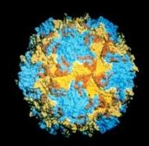
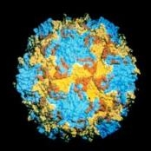
VAD ÄR POLIO?
Barn under 5
Mycket smittsamt
Kan inte botas
Förorenat vatten
Kan utrotas
Notes:
Drabbar främst barn under 5 år.
En mycket smittsam sjukdom orsakad av poliovirus.
Drabbar nervsystemet och kan orsaka förlamning, i värsta fall döden.
Vilt poliovirus (WPV) kommer in i kroppen genom förorenat vatten eller smittad mat
Polio kan inte botas, bara förebyggas med vaccination.
Polio är en av få sjukdomar som kan utrotas.
Polio mainly affects children under 5 years of age.
Poliomyelitis (polio) is a highly infectious disease caused by the polio virus. It invades the nervous system, and can cause paralysis or even death in a matter of hours.
Wild poliovirus (WPV) enters the body through the mouth, in water or food that has been contaminated with faecal material from an infected person. The virus multiplies in the intestine and is excreted by the infected person in faeces, which can pass on the virus to others.
Polio is one of only a few diseases which can be completely eradicated, such as was the case with smallpox. By eradicating polio, children across the entire world will benefit, and no child need ever again know the pain of polio-paralysis. Most diseases, such as HIV and malaria for example, cannot be eradicated, because the tools to eradicate these are not available. Polio does not have an intermediate host (i.e. it does not affect animals, and the virus cannot live in animals, such as malaria for example in mosquitoes), a safe and effective vaccine is available to protect children from polio
Polio eradication activities are also strengthening routine health services. Thanks to polio eradication activities, an active disease surveillance network has been established in all countries, into which other diseases – including measles – are now being integrated.
The fight against polio is one of the largest and most ambitious globally coordinated health initiative in history.
The polio virus, once thought to verge on eradication, is one of the most contagious diseases in inadequately protected areas. One confirmed case of paralysis is considered an outbreak, as doctors assume it means up to 200 other people may have been exposed to the virus.
These vaccine-derived outbreaks really are a marker of poor vaccination and poor sanitation in the community

Slide 3
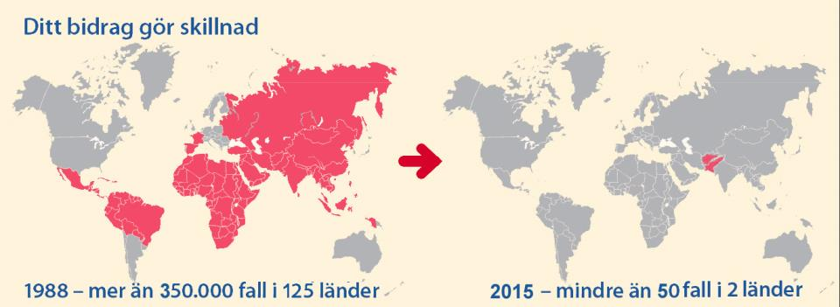
GLOBAL POLIO ERADICATION INITIATIVE 1988
WHO – ROTARY – UNICEF – CDC
2017
2021 - 1 fall i Afghanistan, 1 fall i Pakistan
2
Mer än 2,5 miljarder barn har vaccinerats
Notes:
International efforts to eradicate poliovirus began in the late 1970s when members of Rotary International organized a 5-year campaign to immunize approximately 6.5 million children in the Philippines,
More than 2.5 billion children have received polio vaccinations since the Global Polio Eradication Initiative was launched in 1988, and transmission of wild poliovirus has been interrupted in all but two countries.
CDC - US Centers for Disease Control and Prevention. Amerikanska smittskyddsorganet

Slide 4
POLIOFALL I VÄRLDEN
http://www.polioeradication.org/
Afghanistan Pakistan Nigeria
2015 20 54 0
2016 12 19 4
2017 14 8 0
144 0 0
56 84 0
1 1 0
Notes:
Vaccinorsakad polio = de som insjuknat har smittats av vaccin. Kan hända när man använder poliovaccin som innehåller levande komponenter och vaccinationsnivån på platsen är låg och hygienen dålig. Typiskt i krigsdrabbade områden-
With wild poliovirus type 2 already eradicated since 1999, the aim is to remove the risk of new circulating vaccine-derived poliovirus type 2 (cVDPV2) from emerging, by switching from trivalent OPV (containing type 1, 2 and 3 serotypes) to bivalent OPV (containing only type 1 and 3 serotypes) in routine immunization programmes. Over 90% of cVDPV cases are due to the type 2 component contained in trivalent OPV. - (OPV=Oral polio vaccine)

Slide 5
INSAMLINGSMÅL – 50 MILJONER USD/ÅR I TRE ÅR
Varje klubb bidrar med 1.500 USD/år
Allt matchas av Bill & Melinda Gates
Dessa länder ger mest till polio
USA 60 MUSD
Japan 43 MUSD UK 39 MUSD
Norge 25 MUSD
MUSD = miljoner US $

Slide 7
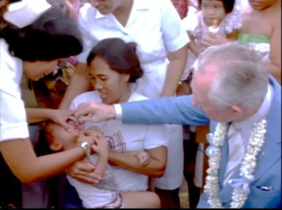
HISTORIEN OM ROTARY& POLIO
1979 - 6 miljoner barn vaccineras i Filippinerna
1985 - PolioPlus lanseras 1988 − Global Polio Eradication Initiative.
1994 − polio utrotad i Nord- och Sydamerika.
2000 − Western Pacific poliofritt
2004 − Sex länder återstår
2009 − Bill & Melinda Gates Foundation
Notes:
The Plus in PolioPlus is thus a broad agenda. Through immunisation, we will be able to serve the causes of education and social development. Thanks to the visionary leadership of great Rotarians, like Clem Renouf and Carlos Canseco.
- PolioPlus lanseras, det första och största internationella hälsoprojektet
1988 - Rotary International och Världshälsoorganisationen lanserar the Global Polio Eradication Initiative. Det finns ca 350,000 poliofall i 125 länder
2000 − Western Pacific region, från Australia till Kina poliofritt
2004 − Sex länder återstår med polio – Afghanistan, Egypten, India, Niger, Nigeria, Pakistan
2009 − Bill & Melinda Gates Foundation lovar 355 miljoner dollar till polio
https://rotarynewsonline.org/what-is-the-plus-in-polioplus/

Slide 8
ROTARY& POLIO - HISTORIEN
2011 − Rotarys finansiering av polioutrotningen överstiger 1 miljard dollar.
2014 − Indien 3 år utan polio. WHO förklarar Sydostasien poliofritt..
20?? − Hela världen är poliofri

Slide 9
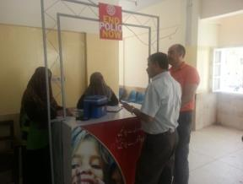
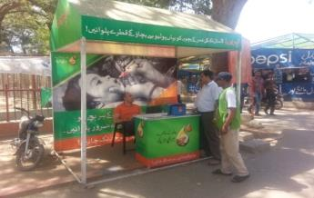
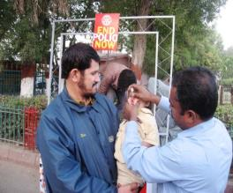
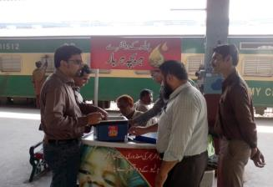
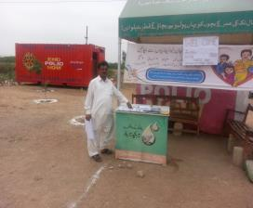
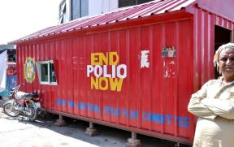
Vaccinationskiosker vid publika platser för att nå alla barn
PAKISTAN NÅR FLER BARN TROTS UTMANINGAR
Inside high rise building in Saddar
Safari Park
Sinbad Amusement Park
Badami Bagh Bus Stand,
Lahore
Karachi Cantt. railway station
Super Highway toll Plaza
Alladin Park
21
Notes:
In spite of these challenges, Rotarians in Pakistan and our partners are finding creative solutions to immunize children wherever they are such as at these vaccination kiosks and Permanent Transit Points installed in public places.

Slide 10
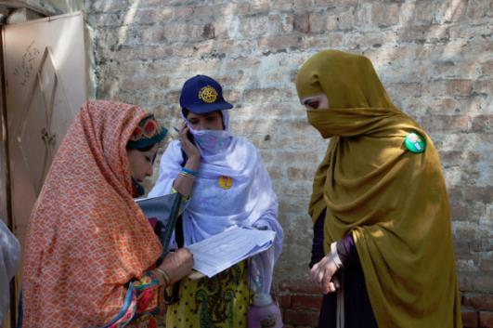
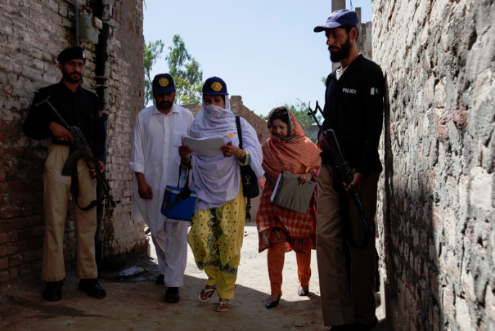
PAKISTAN
Notes:
In Pakistan, health workers traditionally report important polio, maternal and newborn health data using paper reporting. During national polio immunization campaigns, health workers vaccinate every single child in Pakistan under the age of five in just a few days – more than 35 million children.
In high-risk areas in Pakistan, security concerns sometimes prevent health workers from reaching all children with the polio vaccine. Cell phone reporting allows health workers to quickly alert polio partners about missed children, who develop strategies to safely access them with the life-saving vaccine. Here, local police provide protection to health workers going door-to-door immunizing children under the age of five.
A bomb attack in Quetta, Pakistan took the lives of 15 security personnel outside a polio immunization center. Those killed were protecting vaccinators who were preparing to conduct polio immunization
campaigns as part of National Immunization Day campaigns.

Slide 11
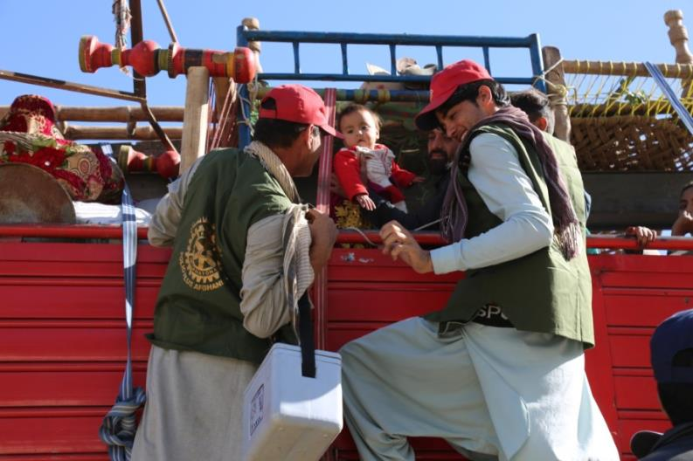
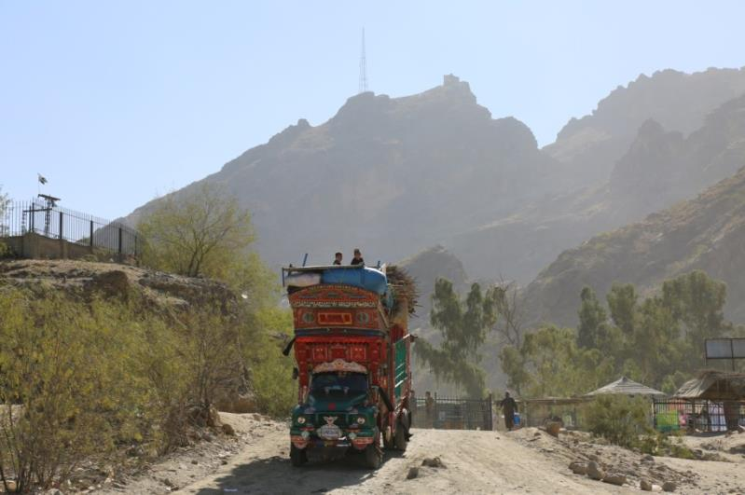
VID GRÄNSÖVERGÅNGARNA VACCINERAS DET
Notes:
Gränsövergångarna Pakistan-Afghanistan
Polio vaccinators climb onto a truck to vaccinate a child at the Torkham border in Nangarhar, the busiest border crossing in Afghanistan. Over 50,000 children have been vaccinated with the oral polio vaccine (OPV) at this border crossing since July this year by vaccination teams supported by the Ministry of Public Health, WHO and UNICEF. Currently polio teams are working at 17 cross-border points to ensure that all children entering Afghanistan get immunized against polio. Over 280 Permanent Transit Teams (PTTs) vaccinate children who travel in and out of security-compromised areas and children traveling to other destinations to ensure that every child on the move receives two drops of the oral polio vaccine to grow up healthy.

Slide 12
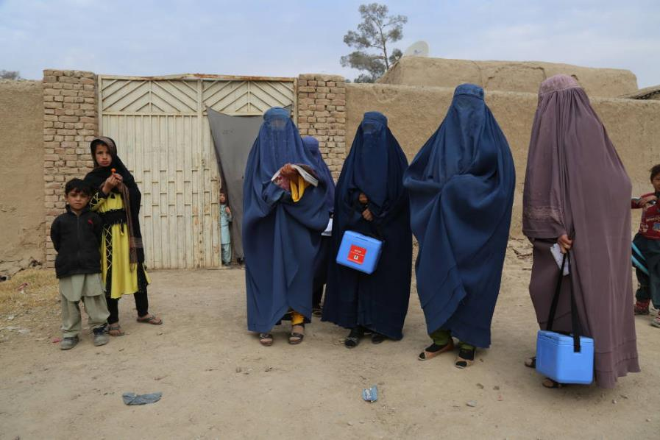
KVINNOR VACCINERAR FRAMGÅNGSRIKT I AFGHANISTAN
Notes:
There are almost 70 000 front line polio workers in Afghanistan, of whom less than 10% are female. This is possibly the largest female workforce in Afghanistan.
Some regions have more female workers than others. In urban areas, around third of the workers are female, whereas in rural areas the proportion is much lower.
The role of females is crucial however.
“Before we had female polio workers, we were missing children who were newborn and sleeping. When the men were working in town, there was often no-one who could take the children out of the house to be vaccinated when the teams knocked on the gates. Females can enter the houses, but males cannot.”

Slide 13
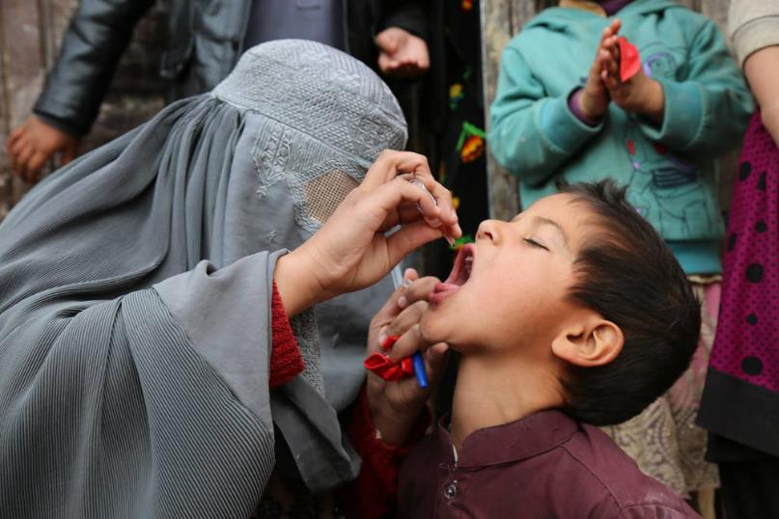
VACCINERING I AFGHANISTAN
Notes:
Women like Zainab are on the frontline of polio eradication, ensuring vaccines reach every child, every time. A five-year-old boy, Waris, is vaccinated against polio in Loya Wala, Kandahar.
WHO / Tuuli Hongisto

Slide 14
SEK 140
SEK 460
SEK 927
SEK 3 245
$ kurs 2016-10-10

Slide 15
PARTNERS
GOVERNMENTS OF THE WORLD
GOVERNMENTS OF THE WORLD
GOVERNMENTS OF THE WORLD
Notes:
The Global Polio Eradication Initiative partners include WHO, UNICEF, the US Centers for Disease Control and Prevention and the Gates Foundation. And equally as important are the governments of the world-both donor and polio-affected and high risk, whose support and leadership is needed to carry out polio immunization activities.
Rotary’s role in the Global Polio Eradication Initiative is fundraising, advocacy, raising awareness and grassroots participation.

Slide 16
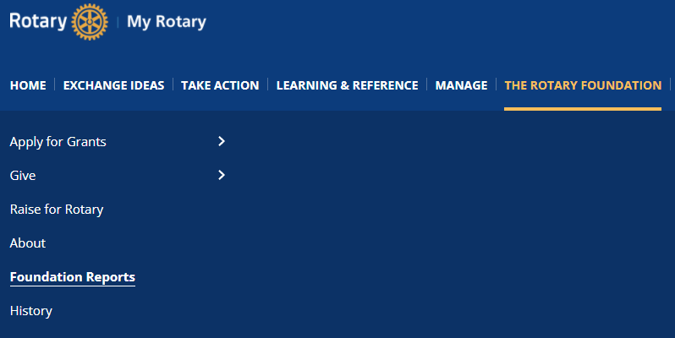
HÄR HITTAR DU RAPPORTER
Du måste logga in på MyRotary

Slide 17
LÄNKAR
Global Polio Eradication Initiative http://polioeradication.org/who-we-are/
EndPolioNow https://www.endpolio.org/

